Slide 1
Tableau Mini Project

Slide 2
The dashboard and story are about credit risk information. We have data that gives us information about a number of people who make loans. These people have different levels of education, who have made different loans and for different reasons. whether short term or long term. Men and women of all ages.

Slide 3
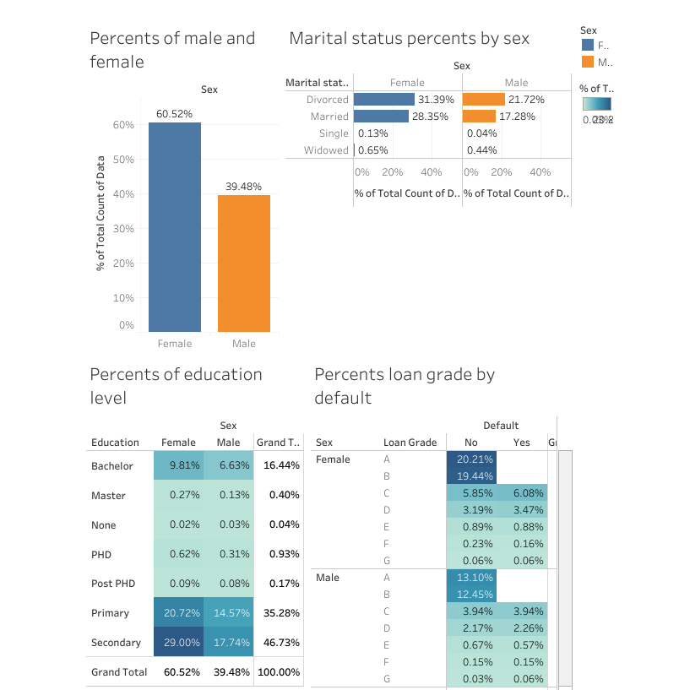

Slide 4
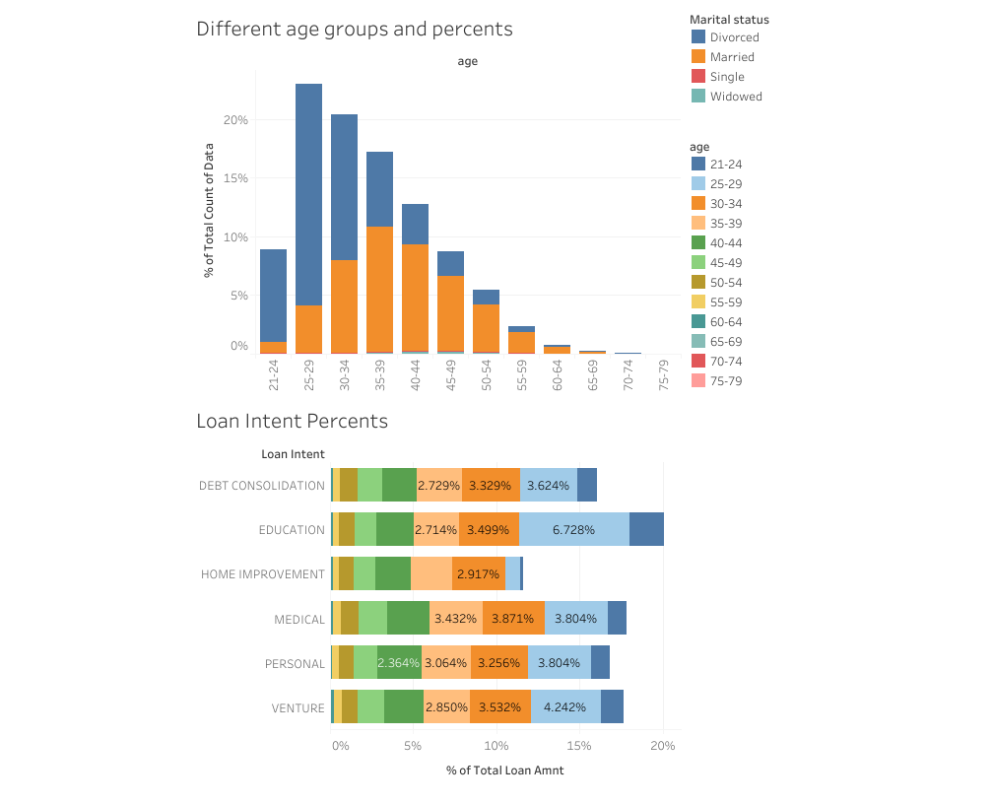

Slide 5
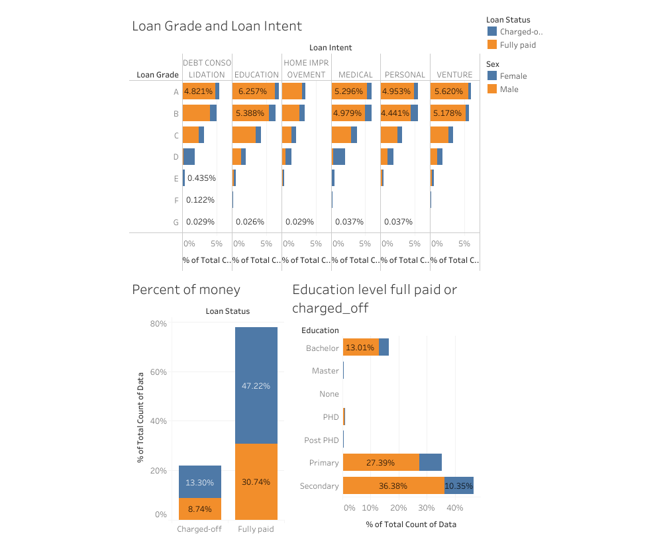

Slide 6
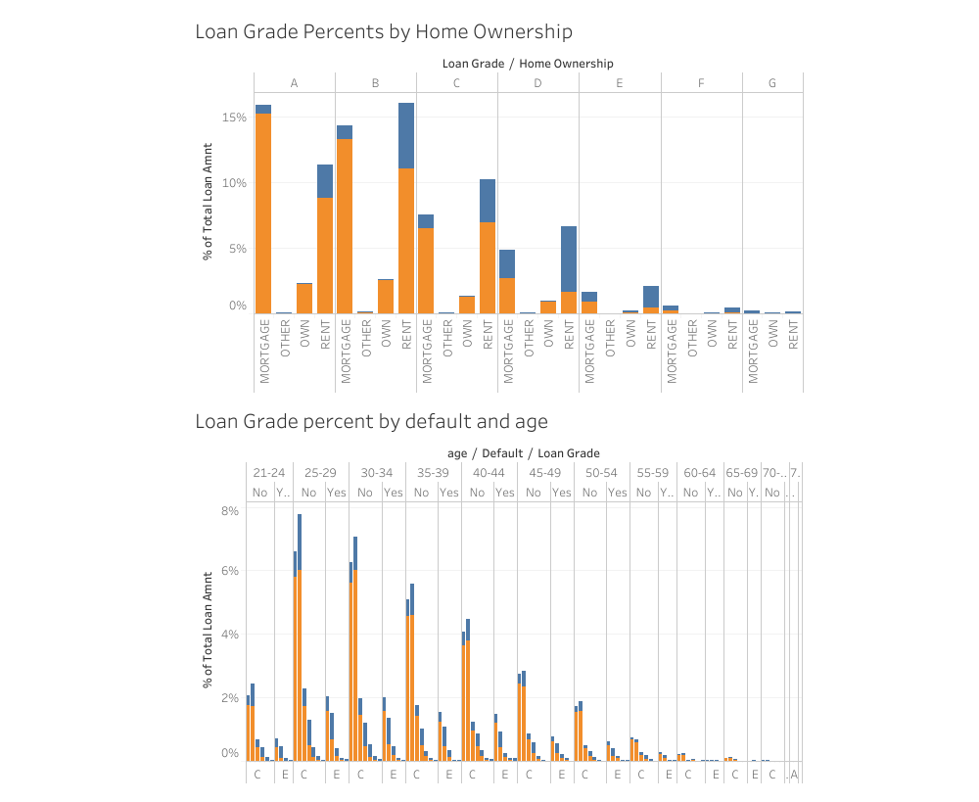

Slide 7
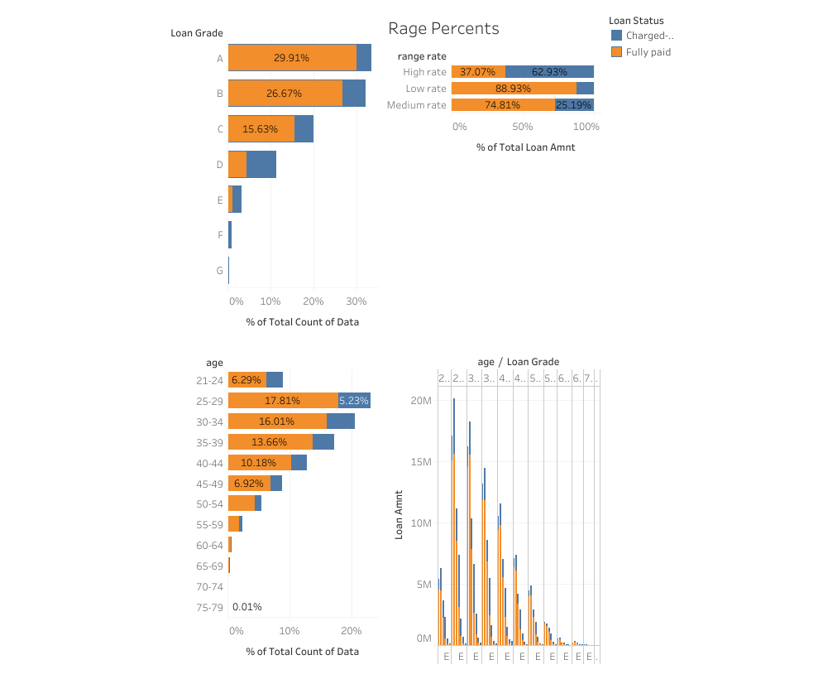

Slide 8
We have noticed that women make more loans than men. but more importantly, the unpaid rate is much higher. what we have to do is.
First, for people in the A category, avoid making loans with high interest rates between the ages of 70 and 74. The D, E, F and G categories should be avoided. It is also preferable to make homeowner loans and mortgages, as these people have a much better chance of repaying their loans.

